Slide 1
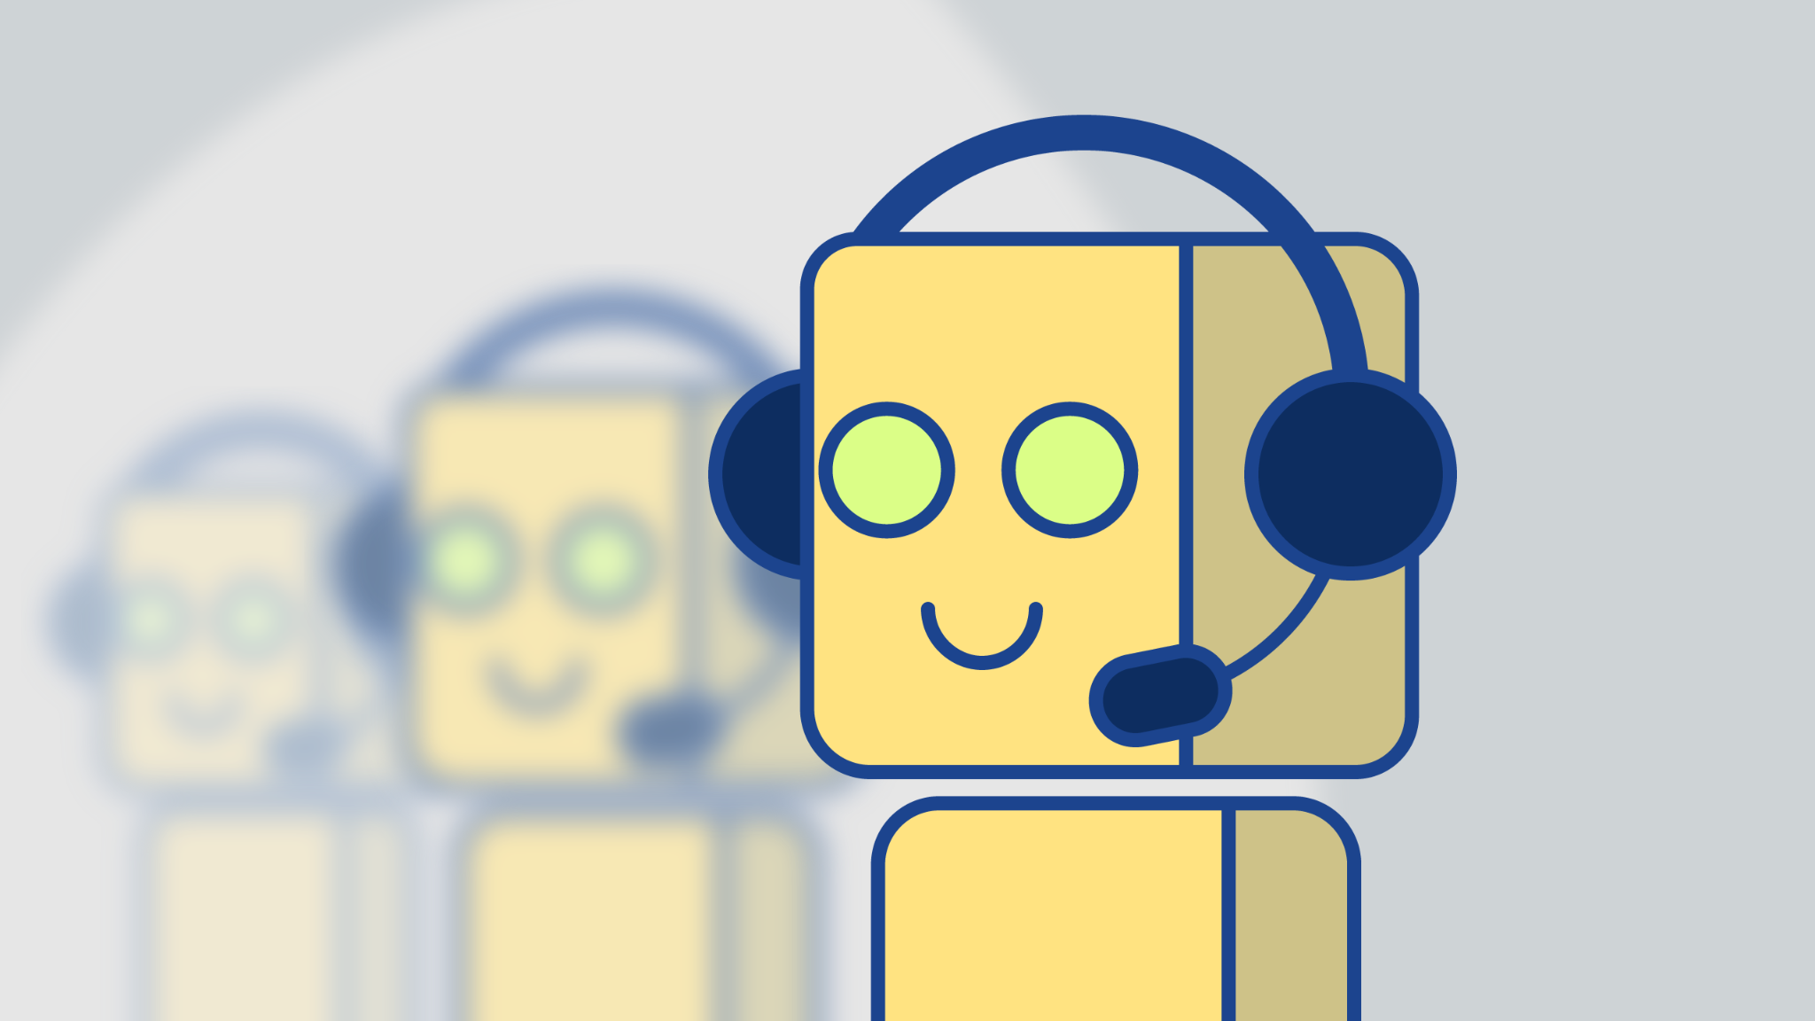
Price Negotiator Ecommerce Chatbot System
By - Krishna Bakshi

Slide 2
Overview
Building a Price Negotiator Ecommerce Chatbot that uses AI to negotiate product prices with consumers.
How it works ?
When browsing products on an ecommerce website like amazon or Best buy, consumers can use the chatbot to negotiate product prices the same way consumers would do in a real physical store with a sale associate. Chatbot may offer them a reduced price or some other offer/deal, Chatbot assisting customers could result in the reduction of chances that customer leaves the website without making a purchase.

Slide 3
Technologies
1)Python for coding and training the chatbot using NLP and machine learning libraries.
2)Frameworks - Chatterbot ,IBM watson, Amazon Lex.
3)Streamlit or Flask for creating the Web API for the chatbot.
4)AWS or Heroku to host to final chatbot web API.

Slide 4
Thanks.

